Slide 1


AESO Power Grid Platform
End-to-End Hybrid Data Architecture leveraging ClickHouse, Redpanda (Kafka), dbt, and Grafana for Alberta Grid Monitoring.

Slide 2


Executive Summary & Purpose
Zero-Latency Telemetry
Hybrid Path Architecture
Simulates continuous sensor feeds from the Alberta Electric System Operator (AESO) power grid. Operates with sub-second ingestion to compute live regional load and generation metrics across Alberta.
Combines ClickHouse Materialized Views for immediate operational dashboarding (5s auto-refresh in Grafana) alongside dbt Core for governed, quality-tested batch analytics models.

Slide 3

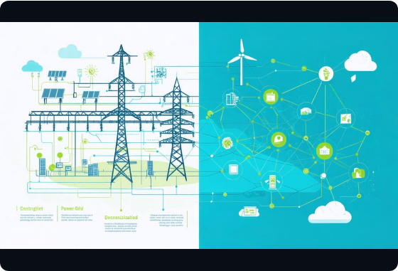


System Architecture
Dual-Path Processing Pipeline
Sensors push telemetry directly into Redpanda (Kafka protocol). ClickHouse streams raw events into high-throughput storage engines, fanning out into two distinct processing channels:
REAL-TIME OPERATIONAL PATH
BATCH GOVERNANCE PATH
ClickHouse Materialized Views + SummingMergeTree driving 5s Grafana refreshes.
dbt Core incremental models executing automated data quality & validation tests.

Slide 4






Technology Stack
Redpanda
ClickHouse
dbt Core
Grafana
C++ based, lightweight Kafka-compatible event streaming platform handling real-time grid sensor ingestion with zero JVM dependencies.
Column-oriented analytical database providing high-throughput appends, fast primary key range filtering, and server-side aggregation.
Analytics engineering framework managing incremental transformations, gold layer modeling, schema constraints, and quality tests.
Real-time operational dashboarding connected to ClickHouse native plugin for 5s live streaming grid metrics visualization.

Slide 5
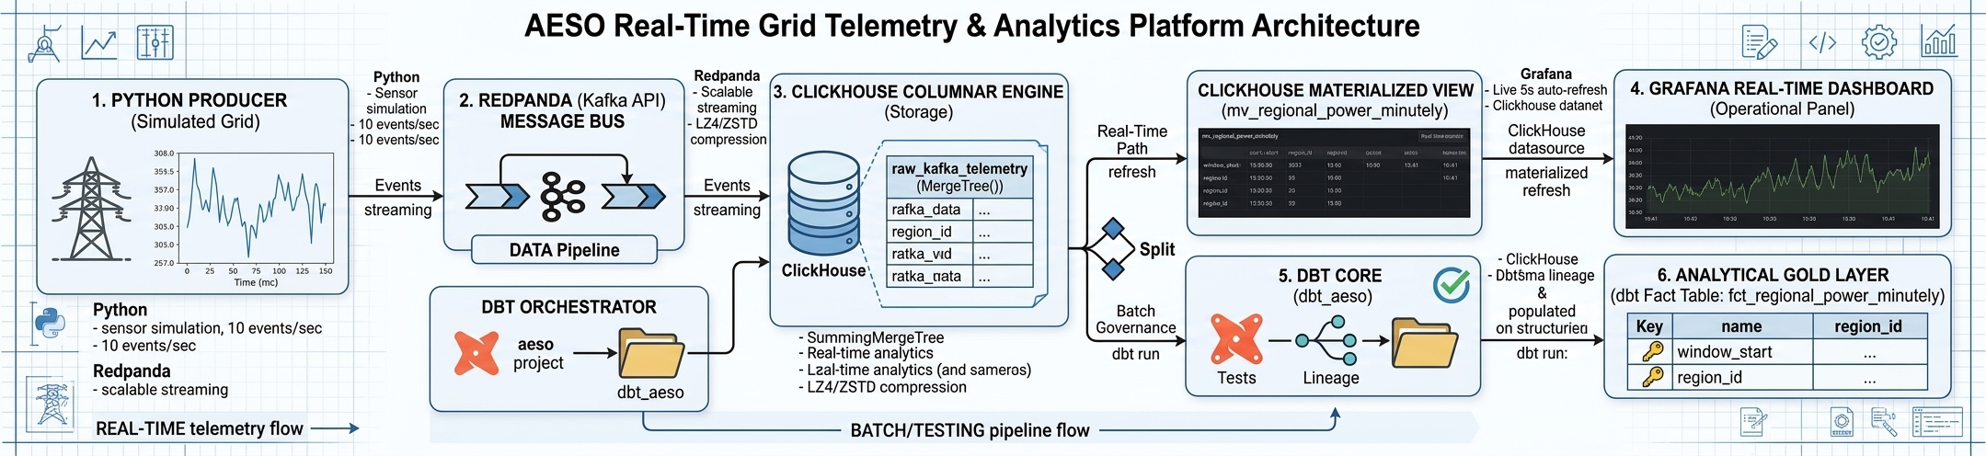

Slide 6






End-to-End Data Pipeline
REAL-TIME PATH (MATERIALIZED VIEW)
GOVERNED PATH (DBT TRANSFORMATIONS)
Continuous server-side minutely aggregations backed by SummingMergeTree. Feeds Grafana dashboards directly with near-zero latency query execution.
Executes incremental models (fct_regional_power_minutely) enforcing data contracts, schema validation, and lineage documentation.

Slide 7


Performance Metrics
Sub-Second Index Skip Rates
5s
By leveraging ClickHouse MergeTree and sparse indexing on low-cardinality keys, queries scan minimal data blocks during execution.
Live Dashboard Refresh
Aligns repeating metadata to maximize block compression (LZ4/ZSTD) and optimize operational IO performance.

Slide 8
Data Schema & Modeling
Layer | Object / Table Name | Engine / Type | Key Purpose
Ingestion | kafka_telemetry_stream | Kafka Engine | Consumes JSON grid feeds directly from Redpanda topic
Raw Storage | stg_raw_telemetry | MergeTree | Columnar primary append-only store with LZ4 compression
Real-Time MV | mv_regional_power_minutely | SummingMergeTree | Pre-aggregates megawatt production by minute server-side
Gold Layer | fct_regional_power_minutely | dbt Incremental | Governed analytical layer with enforced schema tests

Slide 9
Key Architectural Decisions
LowCardinality(String) Optimization: Applied to repeating categorical fields like region_id and asset_type to store dictionary keys, vastly reducing memory footprint and disk IO.
Float32 Precision Balancing: Numerical metrics utilize Float32 rather than high-precision decimals to ensure hyper-efficient vector processing in ClickHouse CPU registers.
Server-Side Aggregations: Utilizing ClickHouse Materialized Views eliminates runtime calculation overhead during live Grafana dashboard updates.
Automated Quality Assertions: dbt tests validate not_null conditions and primary key constraints prior to analytical query exposure.

Slide 10
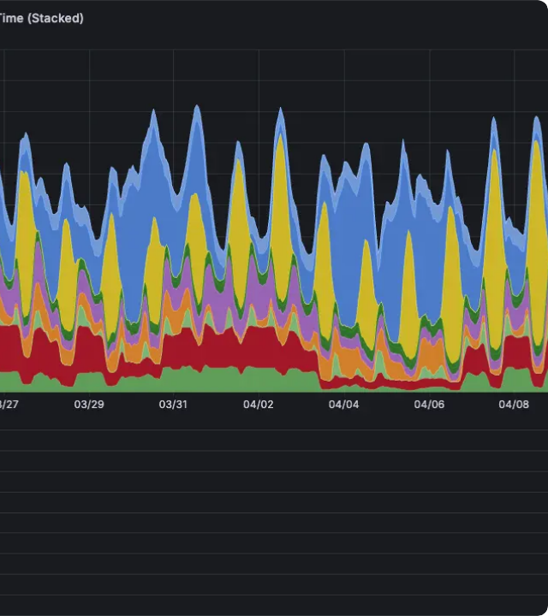
Operational Monitoring
Live Grafana Dashboarding
The operational path streams minute-by-minute energy grid telemetry directly to Grafana with a 5-second auto-refresh interval.
System operators monitor power grid generation, load balance, and regional anomalies across Alberta in real time without querying heavy raw tables.

Slide 11




Deployment Quickstart
Step 2: Initialize DDL
Step 4: dbt & Grafana
Execute SQL scripts for Kafka tables and Materialized Views in ClickHouse.
dbt run && dbt test Transform gold datasets and inspect live Grafana UI.
Step 1: Containers
Step 3: Producer
docker compose up -d Launch ClickHouse, Redpanda, and Grafana stack.
python producer.py Stream real-time AESO grid telemetry events into Redpanda.

Slide 12


Image Sources
https://www.build-news.com/wp-content/uploads/2025/09/decentralized_energy_infrastructure_transformation.jpeg
Source: www.build-news.com
https://image-transformer.coolify.kstg.io/image/https://minio.coolify.kstg.io/kstg-web-prod/widget-generation-mix-over-time.png?2026-04-23T10%3A25%3A18.429Z=&width=3840&quality=75
Source: kickstage.com

